Slide 1
Symbolism of the Tabernacle
Symbolism of the Tabernacle
YouTube
Tabernacle of Moses

Slide 2
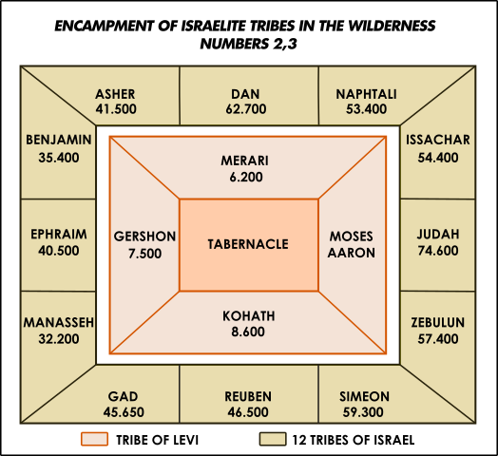
Symbolism of the Tabernacle – Encampment of the Tribes
Symbolism of the Tabernacle
8th oldest
Zilpah
5th oldest
By Bilah
6th oldest
By Bilah
12th oldest by Rachel
9th oldest
By Leah
11th oldest by Son of Joseph
4th oldest
By Leah
10th oldest by Son of Joseph
8th oldest
By Leah
7th oldest
By Zilpah
Oldest
By Leah
2nd oldest
By Leah
Rabbi Carl Perkins
https://images.shulcloud.com/13691/uploads/Bmidbar_5.23.20.pdf
Cursed by Jacob

Slide 3
Symbolism of the Tabernacle – Judah at the Entrance
Symbolism of the Tabernacle
8th oldest
Zilpah
5th oldest
By Bilah
6th oldest
By Bilah
Jacob’s Blessing on Judah
Genesis 49:8-10
^{Ge 49:8} “Judah, your brothers will praise you; your hand will be on the neck of your enemies; your father’s sons will bow down to you.
^{Ge 49:9} You are a lion’s cub, O Judah; you return from the prey, my son. Like a lion he crouches and lies down, like a lioness—who dares to rouse him?
^{Ge 49:10} The scepter will not depart from Judah, nor the ruler’s staff from between his feet, until he comes to whom it belongs and the obedience of the nations is his.
12th oldest by Rachel
9th oldest
By Leah
11th oldest by Son of Joseph
4th oldest
By Leah
10th oldest by Son of Joseph
8th oldest
By Leah
7th oldest
By Zilpah
Oldest
By Leah
2nd oldest
By Leah
Rabbi Carl Perkins
22,300 Levites
604,400 Israelites
https://images.shulcloud.com/13691/uploads/Bmidbar_5.23.20.pdf

Slide 4
Symbolism of the Tabernacle – The White Linen Curtain
Symbolism of the Tabernacle
White Linen Curtain
The Righteous acts of the Saints
Wedding Clothes
^{Rev 19:8} Fine linen, bright and clean, was given her to wear.” (Fine linen stands for the righteous acts of the saints.) ⁹ Then the angel said to me, “Write: ‘Blessed are those who are invited to the wedding supper of the Lamb!’
YouTube
Tabernacle of Moses

Slide 5
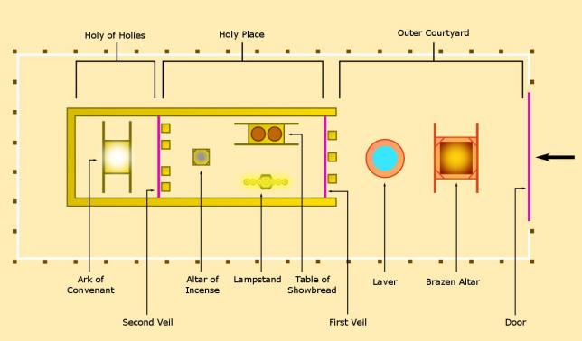
Symbolism of the Tabernacle – East Facing
Symbolism of the Tabernacle
North
Isa 60:1 “Arise, shine, for your light has come, and the glory of the LORD rises upon you. 2 See, darkness covers the earth and thick darkness is over the peoples, but the LORD rises upon you and his glory appears over you. 3 Nations will come to your light, and kings to the brightness of your dawn.
East
Rev 22:16 “I, Jesus, have sent my angel to give you this testimony for the churches. I am the Root and the Offspring of David, and the bright Morning Star.”
https://graceandtruthdotme2.files.wordpress.com/2015/10/tabernacle.png

Slide 6
Symbolism of the Tabernacle – Entrance Curtain Colors
Symbolism of the Tabernacle
Blue
Purple
Scarlet
White Linen
YouTube
Tabernacle of Moses

Slide 7
Symbolism of the Entrance Curtain
http://www.minimannamoments.com/a-mystery-how-messiah-takes-blue-and-red-threads-to-make-purple-people/

Slide 8
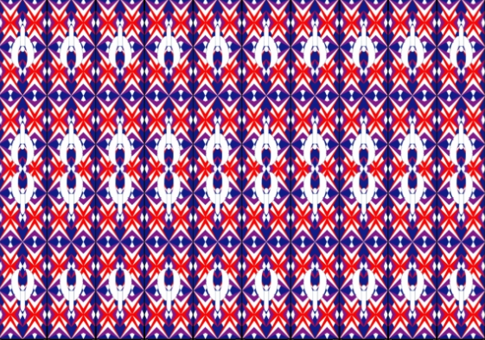
Symbolism of the Tabernacle – Entrance Curtain Colors
Symbolism of the Tabernacle
Blue: The color of the heavens.
Purple: The color of royalty. God is above all earthly kings, Christ is the King of kings (1 Timothy 6:15, Revelations 19:16).
Red: The color of the blood. Atonement for sin was only through a blood sacrifice. Jesus, our Redeemer, redeemed us through his blood (1 Peter 1:18-19).
White Linen: The color of purity and righteousness.
https://narrowgateentrance.com/moses-tabernacle/

Slide 9
Symbolism of the Tabernacle – The Courtyard
Symbolism of the Tabernacle
Exodus 27:9-15
50 x 25 yards
Enclosed by Linen curtains 7 ½ ft high
Bronze Altar
Wash Basin
Tabernacle
YouTube
Tabernacle of Moses

Slide 10
Symbolism of the Tabernacle – The Bronze Altar
Symbolism of the Tabernacle
Altar – Bronze Covered Acacia Wood
4 ½ feet high, 7 ½ feet square
Burnt offerings for Israel’s Sin
Morning and Evening
Day of Atonement
Offerings for Individual’s Sin
Sin
Guilt
Thanks
Healing
Purification
Consecration
Symbolism of Christ - the cross
22,300 Levites
604,400 Israelites
YouTube
Tabernacle of Moses
This is an illustration for the present time, indicating that the gifts and sacrifices being offered were not able to clear the conscience of the worshiper. (Hebrews 9:9)
But when this priest had offered for all time one sacrifice for sins, he sat down at the right hand of God. (Hebrews 10:12)

Slide 11
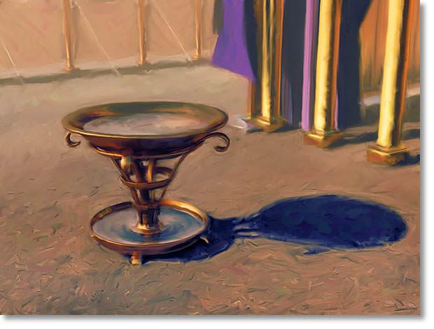
Symbolism of the Tabernacle – The Wash Basin
Symbolism of the Tabernacle
Exodus 30:17-21
Priests were to wash hands and feet before entering Tent of the Meeting (or death). Ex 30:20
Sacrifices washed before burned
Water a symbol of cleansing, baptism, Holy Spirit
Just as priests could not enter God’s presence without washing, we cannot enter his presence with being born again by water and spirit. (John 3:3-5)
In reply Jesus declared, “I tell you the truth, no one can see the kingdom of God unless he is born again.”
“How can a man be born when he is old?” Nicodemus asked. “Surely he cannot enter a second time into his mother’s womb to be born!”
Jesus answered, “I tell you the truth, no one can enter the kingdom of God unless he is born of water and the Spirit.” (John 3:3-5)
https://www.walkingtogetherministries.com/2017/08/31/exodus-3017-21/

Slide 12
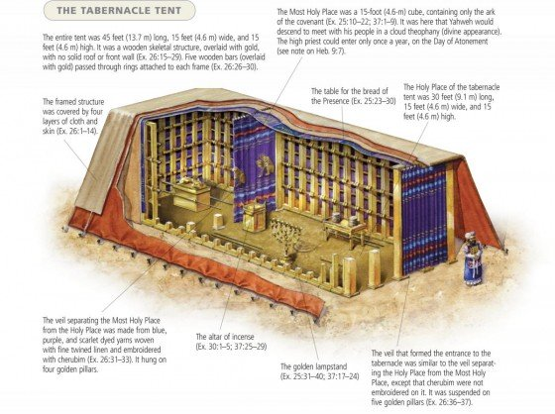
Symbolism of the Tabernacle – The Tent of the Meeting
Symbolism of the Tabernacle
The Tabernacle, Tent of the Meeting
45 feet x 15 feet x 15 feet
Gold covered acacia wood frames, 2 ½‘ wide x 15‘ high
2 room divided by a curtain
Holy Place (30x15’)
Bread of the presence
Lamp (Menorah)
Altar of Incense
Most Holy Place or Holy of Holies (15x15’)
Ark of the Covenant
Four outer coverings
Linen curtains: blue, purple, scarlet, white
Goat hair
Red-dyed ram’s skins
Leather (sea cow or badger[King James])
Pinterest
israel-a-history-of.com

Slide 13
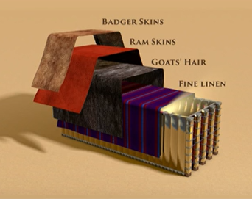
Symbolism of the Tabernacle – Tabernacle Coverings
Symbolism of the Tabernacle
Leather
No exterior beauty, Isaiah 53:2
Red-Dyed Ram Skins
Blood shed to cover Israel’s sin
Goat Hair
Black – Sin of Israel
or White – Sin of Israel Cleansed
Curtains of the Tabernacle
Blue - Heaven
Purple - King
Scarlet – Blood Sacrifice
White Linen - Righteousness
(Sea Cows) Seal / Porpoise / manatee
He had no beauty or majesty to attract us to him, nothing in his appearance that we should desire him. He was despised and rejected by men, a man of sorrows, and familiar with suffering. (Isaiah 53:2-2)
https://emmausroadministries.international/2016/12/07/four-times-covered/

Slide 14
Symbolism of the Tabernacle – The Holy Place
Symbolism of the Tabernacle
YouTube
Tabernacle of Moses

Slide 15
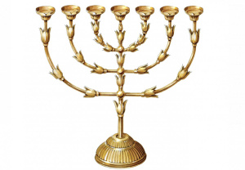
Symbolism of the Tabernacle – The Lamp
Symbolism of the Tabernacle
Exodus 25:31-40, Exodus 37:17-24
Unleavened Bread
Firstfruits
Pentecost
Trumpets
Day of Atonement
Tabernacles
Passover – Jesus crucified on Day of Preparation
Unleavened bread – Jesus in the grave as the sacrifice for sin
First fruits – Jesus rose from the dead on the 3rd day as a first fruit of the resurrection
Pentecost – The Holy Spirit poured out on the church, Christ’s bride and body
Trumpets
Day of Atonement (Leviticus 16:1-34, Leviticus 23:36-32, Numbers 29:7-11)
Tabernacles
The feast of Trumpets, Day of Atonement and Tabernacles was a 15 day celebration of God’s forgiveness of Israel’s sin.
Passover
“I am the light of the world.” (John 8:12)
https://narrowgateentrance.com/moses-tabernacle/

Slide 16
Symbolism of the Tabernacle – Table of Bread of the Presence
Symbolism of the Tabernacle
Exodus 25:23-30. Exodus 37:10-16
Table gold-covered acacia wood
3 ft long 1.5 ft wide, 2.24 ft high
12 loaves of bread
Bread eaten each sabbath
Bread of the presence – 12 loaves for 12 tribes in the literal presence of God
^{Lev 24:8} This bread is to be set out before the LORD regularly, Sabbath after Sabbath, on behalf of the Israelites, as a lasting covenant.
Bread of the Presence is a symbol for the body of Christ we have literal union with.
^{Jn 6:51} “I am the living bread that came down from heaven. If anyone eats of this bread, he will live forever. This bread is my flesh, which I will give for the life of the world.” (John 6:51)
YouTube
Tabernacle of Moses

Slide 17
Symbolism of the Tabernacle – Alta of Incense
Symbolism of the Tabernacle
Exodus 30:1-10, 37:25-28
Gold-covered acacia wood
3ft high x 1.5ft square
Altar for burning incense, not sacrifices
Consecrated with blood each Day of Atonement
Smoke of incense symbolic of the prayers rising to heaven
“O LORD, I call to you; come quickly to me. Hear my voice when I call to you. ² May my prayer be set before you like incense; may the lifting up of my hands be like the evening sacrifice” (Psalm 141:1-2)
Altar of Incense is symbolic of Christ’s ministry of intercession.
“During the days of Jesus’ life on earth, he offered up prayers and petitions with loud cries and tears to the one who could save him from death, and he was heard because of his reverent submission.” (Hebrews 5:7)
YouTube
Tabernacle of Moses

Slide 18
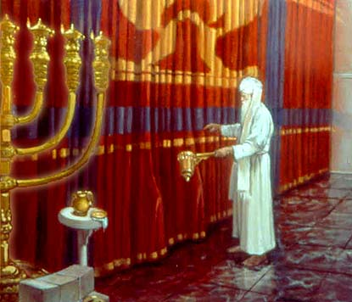
Symbolism of the Tabernacle – The Holy of Holies
Symbolism of the Tabernacle
Curtain to the Holy of Holies was entered one day per year during the Day of Atonement.
The priest would die if entered the Holy of Holy any other day.
The curtain was torn in two at the moment of Jesus’ death, symbolic of the removal barrier of sin between man and God.
And when Jesus had cried out again in a loud voice, he gave up his spirit. At that moment the curtain of the temple was torn in two from top to bottom. The earth shook and the rocks split. (Matthew 27:50-51)
https://the-scarlet-thread.com/2012/05/04/christ-as-the-veil-in-exodus/

Slide 19
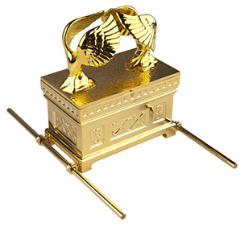
Symbolism of the Tabernacle – Ark of the Covenant
Symbolism of the Tabernacle
Exodus 25:10-20, Exodus 37:1-9
Gold-covered acacia wood
It measured 3’8” long, 2’3” wide, and 2’3” high.
Consecrated once per year on the Day of Atonement
Priest placed his finger dipped in blood on the Cover of Atonement
Sprinkled blood of the sacrificial goat on the cover.
“I will look on you with favor and make you fruitful and increase your numbers, and I will keep my covenant with you. You will still be eating last year’s harvest when you will have to move it out to make room for the new. I will put my dwelling place among you, and I will not abhor you. I will walk among you and be your God, and you will be my people.” (Leviticus 26:9-12)
The Ark of the Covenant symbolized God’s covenant, presence, and provision for his Israel’s sin. These were fulfilled in Christ
God presented him as a sacrifice of atonement, through faith in his blood. (Romans 3:25)
https://www.facebook.com/Ark-of-the-Covenant-

Slide 20
Symbolism of the Tabernacle – Objects in the Ark of the Covenant
Symbolism of the Tabernacle
Objects of the Covenant in the Ark, Hebrews 9:5
The Law – God’s Commands for His People
Exodus 20
Manna – God’s Provision for His People
Exodus 16
Aarons Staff – Obedience of God’s People
Leviticus 26:9-12
YouTube
Tabernacle of Moses

Slide 21
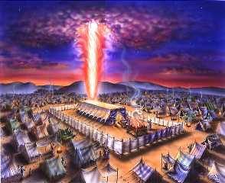
Symbolism of the Tabernacle – The Glory of the LORD
Symbolism of the Tabernacle
Shechinah Glory – from shachan, “to dwell”
God’s Glory filled the Tabernacle
Exodus 40:34-38
God’s Glory filled Solomon’s temple
2 Chronicles 7:1
God’s glory departed Solomon’s temple
Ezekiel 11:22-23
Jerusalem destroyed 586 BC
God’s glory did not return to the second temple
^{Ex 40:34} Then the cloud covered the Tent of Meeting, and the glory of the LORD filled the tabernacle. ³⁵ Moses could not enter the Tent of Meeting because the cloud had settled upon it, and the glory of the LORD filled the tabernacle.
^{Ex 40:36} In all the travels of the Israelites, whenever the cloud lifted from above the tabernacle, they would set out; ³⁷ but if the cloud did not lift, they did not set out—until the day it lifted.
^{Ex 40:38} So the cloud of the LORD was over the tabernacle by day, and fire was in the cloud by night, in the sight of all the house of Israel during all their travels
https://endtimesdarknessdescending.wordpress.com/2019/08/24/america-and-a-four-dimensional-trip-through-the-tabernacle-of-moses/

Slide 22
Symbolism of the Tabernacle – The Glory of the LORD
Symbolism of the Tabernacle
The Word became flesh and made his dwelling among us. We have seen his glory, the glory of the One and Only, who came from the Father, full of grace and truth. (John 1:14)
The Son is the radiance of God’s glory and the exact representation of his being, sustaining all things by his powerful word. After he had provided purification for sins, he sat down at the right hand of the Majesty in heaven. (Hebrews 1:3)
https://endtimesdarknessdescending.wordpress.com/2019/08/24/america-and-a-four-dimensional-trip-through-the-tabernacle-of-moses/

